Slide 1
The Basic Practice of Statistics Ninth Edition David S. Moore William I. Notz
Chapter 6
Two-Way Tables
Lecture Slides
© 2021 W. H. Freeman and Company

Slide 2
In Chapter 6, we cover …
Marginal distributions
Conditional distributions
Relative risk and odds ratio for 2x2 contingency tables
Simpson’s paradox

Slide 3
Categorical variables
Review: Categorical variables place individuals into one of several groups or categories.
The values of a categorical variable are labels for the different categories.
The distribution of a categorical variable lists the count or percent of individuals who fall into each category.
When a data set involves two categorical variables, we begin by examining the counts or percents in various categories for one of the variables.
A two-way table describes two categorical variables, organizing counts according to a row variable and a column variable.

Slide 4
Two-way contingency table
In 2017, the National Center for Education Statistics projected the number of academic degrees to be awarded in 2020–2021 for men and women (Table 6.1 of the textbook)
Sex | Degrees Conferred (thousands): Associate | Degrees Conferred (thousands): Bachelor’s | Degrees Conferred (thousands): Master’s | Degrees Conferred (thousands): Professional/Doctorate | Total
Women | 639 | 1087 | 460 | 97 | 2283
Men | 402 | 804 | 329 | 87 | 1622
Total | 1041 | 1891 | 789 | 184 | 3905
What are the variables described by this two-way table?
How many degrees were conferred (to the nearest thousand)?

Slide 5
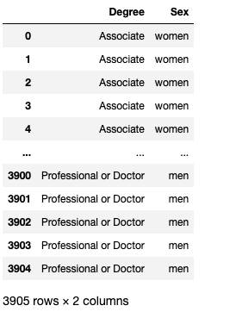
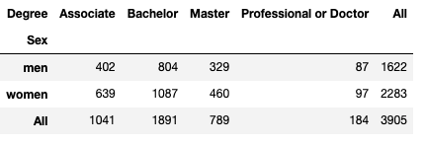
This is how data are collected
Tabulated data

Slide 6
Marginal distribution (1 of 3)
The marginal distribution of one of the categorical variables, in a two-way table of counts, is the distribution of values of that variable among all individuals described by the table.
Note: Percents are often more informative than counts, especially when one is comparing groups of different sizes.
To examine a marginal distribution:
Use the data in the table to calculate the marginal distribution (in percents) of the row or column totals.
Make a graph to display the marginal distribution.

Slide 7
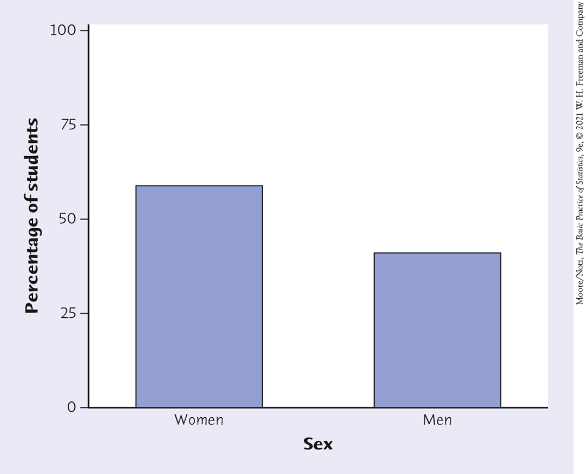
Marginal distribution (2 of 3)
Sex | Degrees Conferred (thousands): Associate | Degrees Conferred (thousands): Bachelor’s | Degrees Conferred (thousands): Master’s | Degrees Conferred (thousands): Professional/Doctorate | Total
Women | 639 | 1087 | 460 | 97 | 2283
Men | 402 | 804 | 329 | 87 | 1622
Total | 1041 | 1891 | 789 | 184 | 3905
Examine the marginal distribution of sex.
Response | Percent
Women | 2283/3905= 58.5%
Men | 1622/3905 = 41.5%

Slide 8
Marginal distribution (3 of 3)
Sex | Degrees Conferred (thousands): Associate | Degrees Conferred (thousands): Bachelor’s | Degrees Conferred (thousands): Master’s | Degrees Conferred (thousands): Professional/Doctorate | Total
Women | 639 | 1087 | 460 | 97 | 2283
Men | 402 | 804 | 329 | 87 | 1622
Total | 1041 | 1891 | 789 | 184 | 3905
Examine the marginal distribution of degree conferred.
Response | Percent
Associate | 1041/3905= 26.7%
Bachelor’s | 1891/3905 = 48.4%
Master’s | 789/3905 = 20.2%
Doctorate | 184/3905 = 4.7%

Slide 9
Conditional distribution (1 of 6)
Marginal distributions tell us nothing about the relationship between two variables.
A conditional distribution of a variable describes the values of that variable among individuals who have a given value of another variable.
Use software to generate a side-by-side bar graph, a segmented bar graph, or a mosaic plot to compare distributions.

Slide 10
Conditional distribution (2 of 6)
A segmented bar graph is a bar graph for presenting data about two categorical variables in which each bar is divided into parts. Each bar represents the observations that take a particular value of one variable, and the length of each part of the bar represents the proportion of those observations that take a specific value of the second variable.
A mosaic plot is a segmented bar graph in which the width of each bar represents the proportion of all observations that fall into the category that the bar represents.

Slide 11
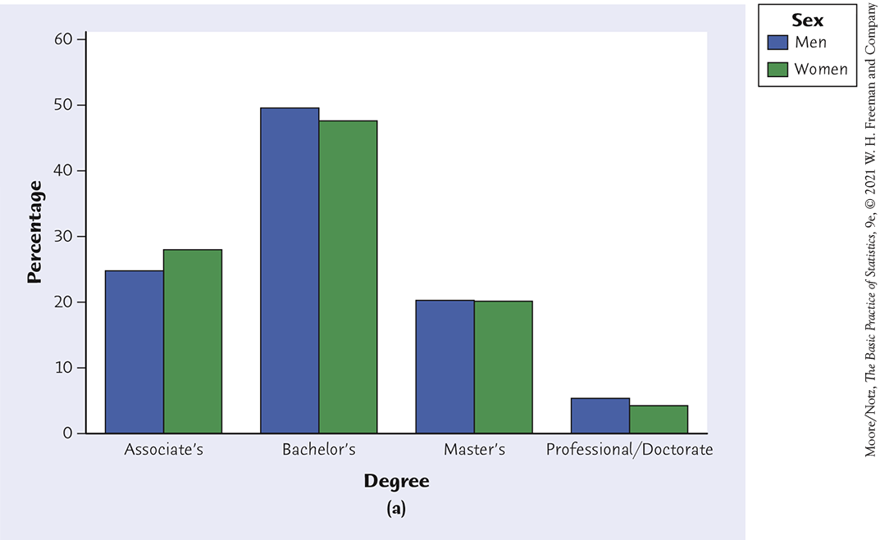
Conditional distribution (3 of 6)
Conditional distribution of degree received given sex
Sum of the heights of the bars for mean should be 100%
Sum of the heights of the bars for women should be 100%

Slide 12
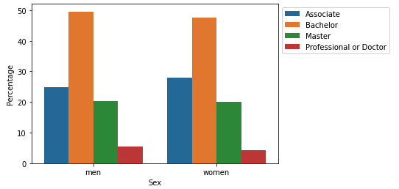
Conditional distribution (4 of 6)
Conditional distribution of degree received given sex
Sum of the heights of the bars for mean should be 100%
Sum of the heights of the bars for women should be 100%
Another way we could plot the conditional distribution of degree received given sex

Slide 13
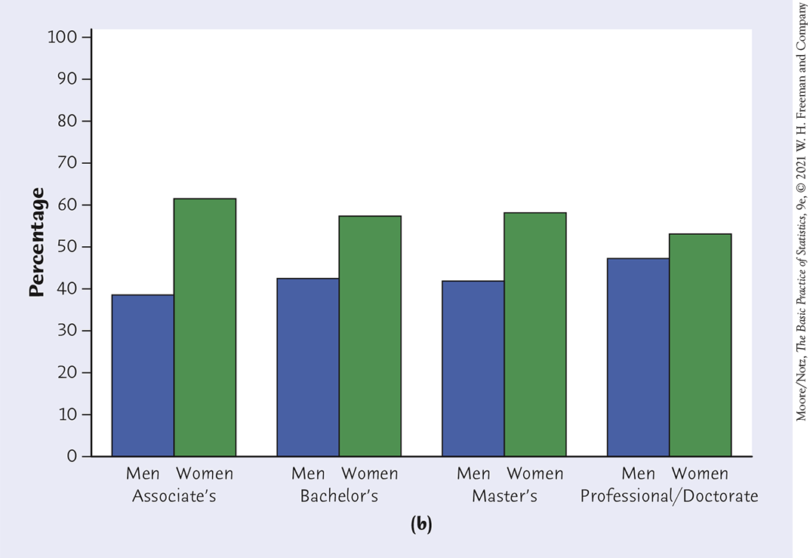
Conditional distribution (5 of 6)
Conditional distribution of degree received given sex
Conditional distribution of sex given degree received
Sum of the heights of the bars for men and women for each degree type should sum to 100%

Slide 14
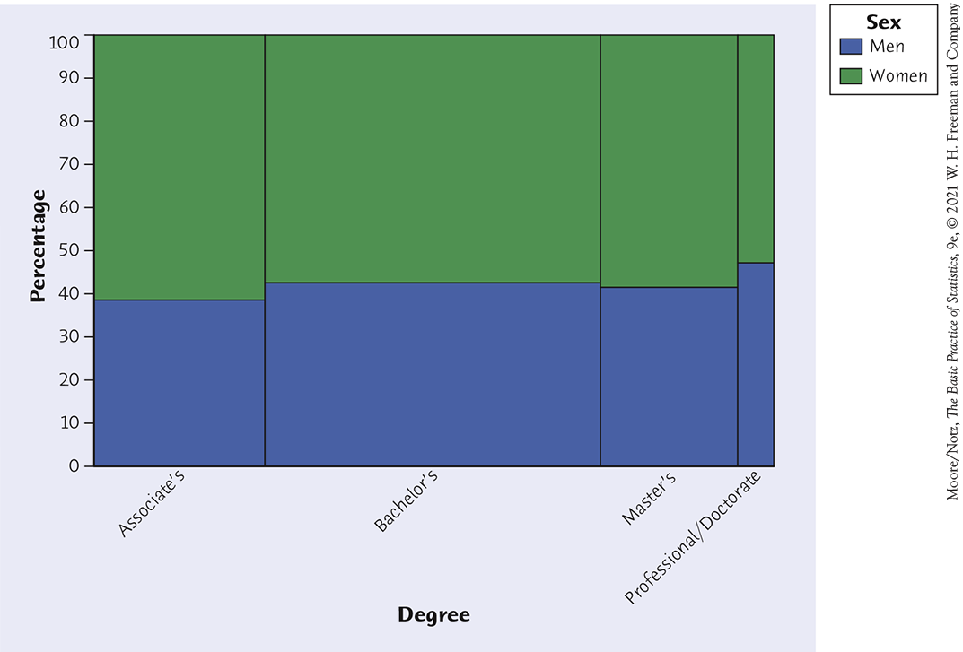
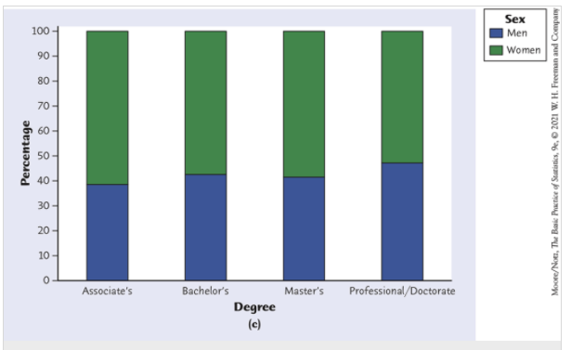
Conditional distribution (6 of 6)
Other plots to show conditional distributions
Mosaic plot and segmented bar graph comparing the proportions of women (green) and men (blue) among those in each degree-conferred category.

Slide 15
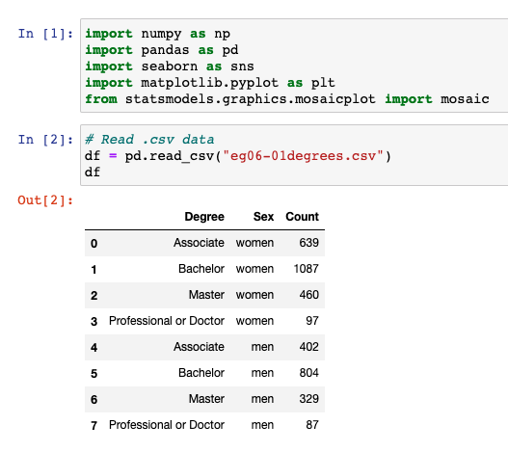
Example 6.3 in Python (1 of 7) Libraries and importing the data

Slide 16
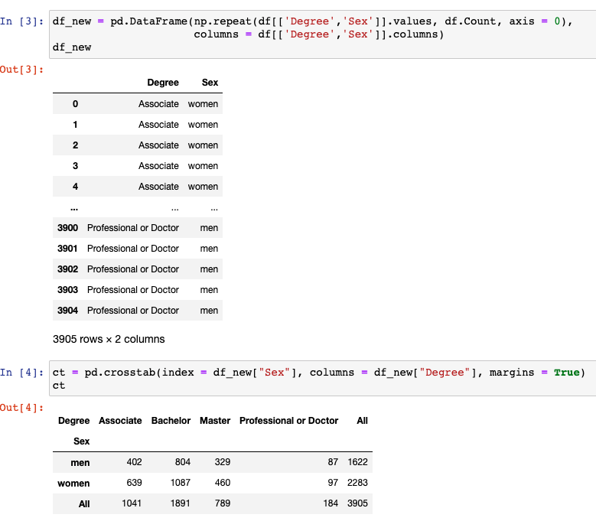
Example 6.3 in Python (2 of 7) Tabulating the data (creating the contingency table)

Slide 17
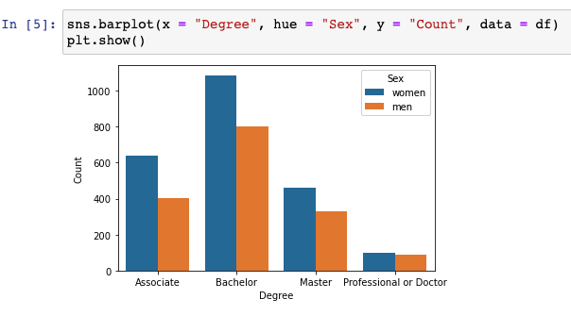
Example 6.3 in Python (3 of 7) Bar plot of table counts

Slide 18
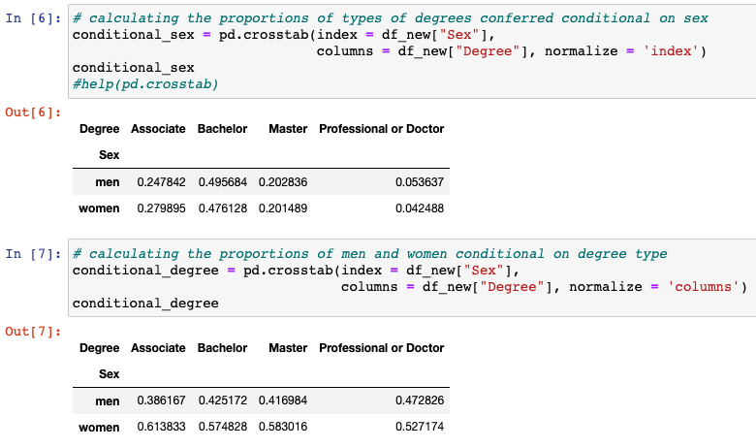
Example 6.3 in Python (4 of 7) Computing the conditional proportions
Conditional distribution of degree received given sex
Conditional distribution of sex given degree received

Slide 19
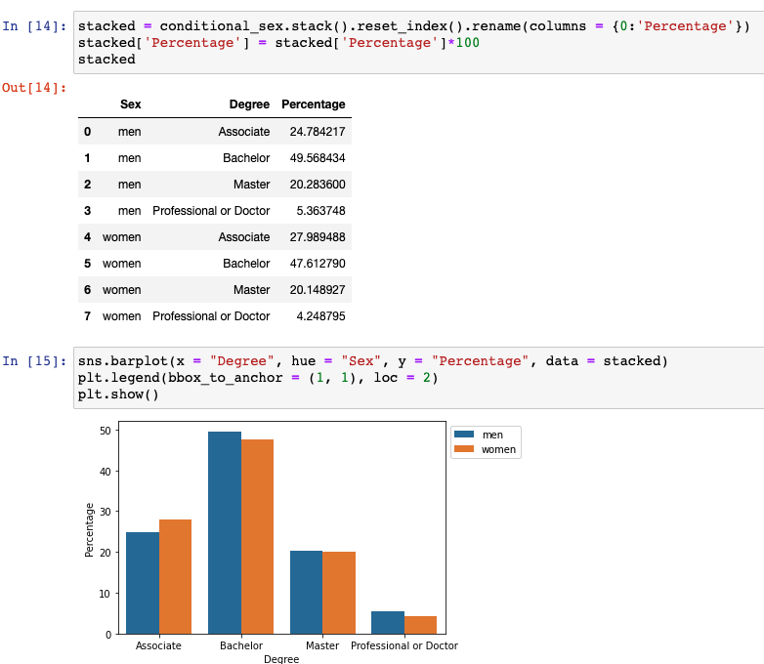
Example 6.3 in Python (5 of 7) Bar plot of conditional distribution of degree received given sex
Conditional distribution of degree received given sex

Slide 20
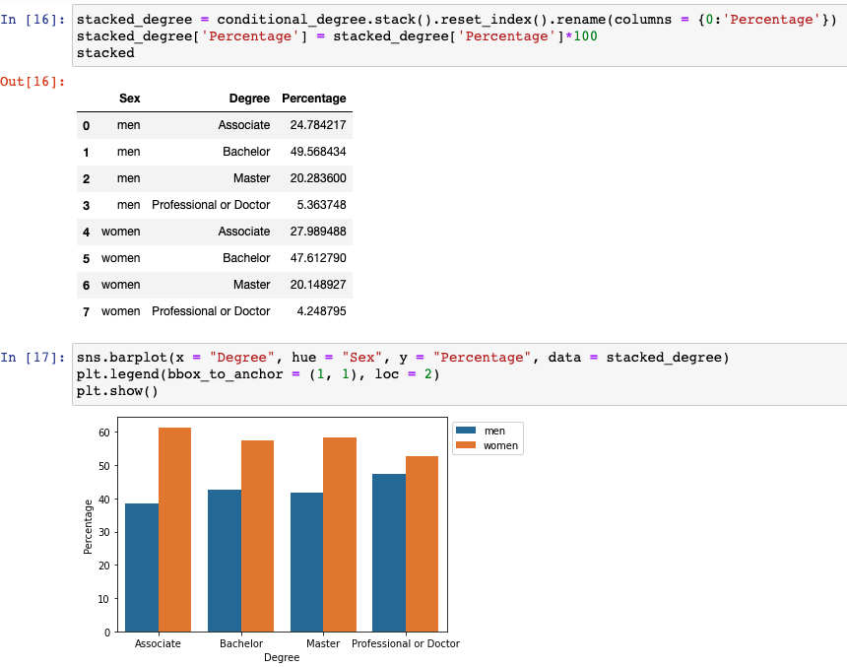
Example 6.3 in Python (6 of 7) Bar plot of conditional distribution of sex given degree received
Conditional distribution of sex given degree received

Slide 21
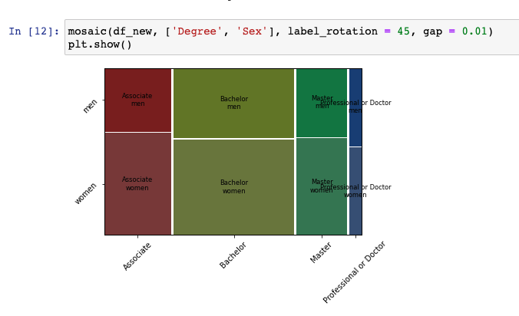
Example 6.3 in Python (7 of 7) Mosaic plot

Slide 22
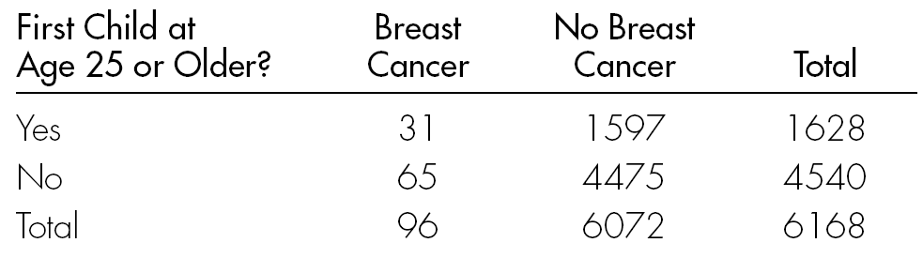
Relative risk and odds ratio for 2x2 contingency tables
Note: a 2x2 table is a two-way table where each categorical variable take only 2 categories
Example of 2x2 contingency table
Source: Pagano and Gauvreau (1988, p. 133).
Copyright ©2005 Brooks/Cole, a division of Thomson Learning, Inc.

Slide 23
Risk, Probability, and Odds
A population contains 1000 individuals, of which 400 carry the gene for a disease. Equivalent ways to express this proportion:
Forty percent (40%) of all individuals carry the gene.
The proportion who carry the gene is 0.40.
The probability that someone carries the gene is .40.
The risk of carrying the gene is 0.40.
The odds of carrying the gene are 4 to 6 (or 2 to 3, or 2/3 to 1).

Slide 24
Risk, Probability, and Odds
Percentage with trait = (number with trait/total)×100%
Proportion with trait = number with trait/total
Probability of having trait = number with trait/total
Risk of having trait = number with trait/total
Odds of having trait = (number with trait/number without trait) to 1

Slide 25
Baseline Risk and Relative Risk
Baseline Risk: risk without treatment or behavior
Can be difficult to find.
If placebo included, baseline risk = risk for placebo group.
Relative Risk: of outcome for two categories of explanatory variable is ratio of risks for each category.
Relative risk of 3: risk of developing disease for one group is 3 times what it is for another group.
Relative risk of 1: risk is same for both categories of the explanatory variable (or both groups).

Slide 26
Example: Relative Risk of
Developing Breast Cancer
Risk for women having first child at 25 or older = 31/1628 = 0.0190
Risk for women having first child before 25
= 65/4540 = 0.0143
Relative risk = 0.0190/0.0143 = 1.33
Risk of developing breast cancer is 1.33 times greater for women who had their first child at 25 or older.
Source: Pagano and Gauvreau (1988, p. 133).

Slide 27
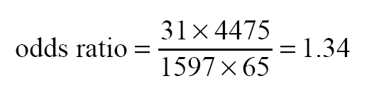
Odds Ratio
Odds Ratio: ratio of the odds of getting the disease to the odds of not getting the disease.
Example: Odds Ratio for Breast Cancer
Odds for women having first child at age 25 or older = 31/1597 = 0.0194
Odds for women having first child before age 25 = 65/4475 = 0.0145
Odds ratio = 0.0194/0.0145 = 1.34
Alternative formula:

Slide 28
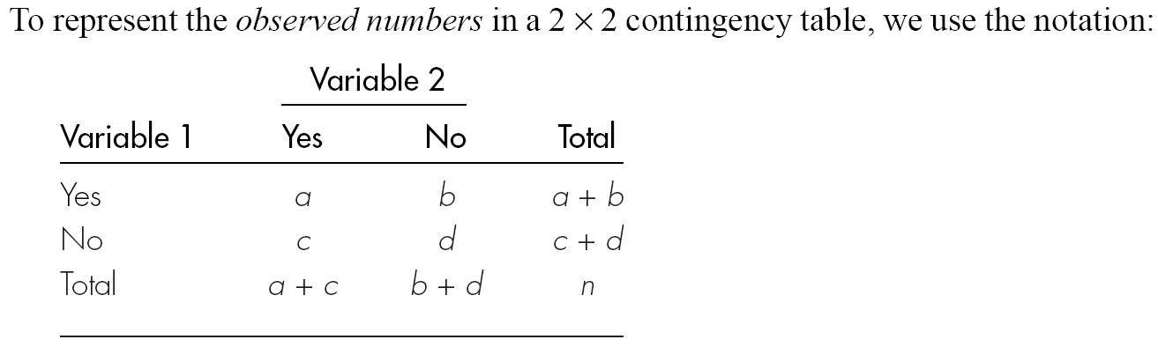
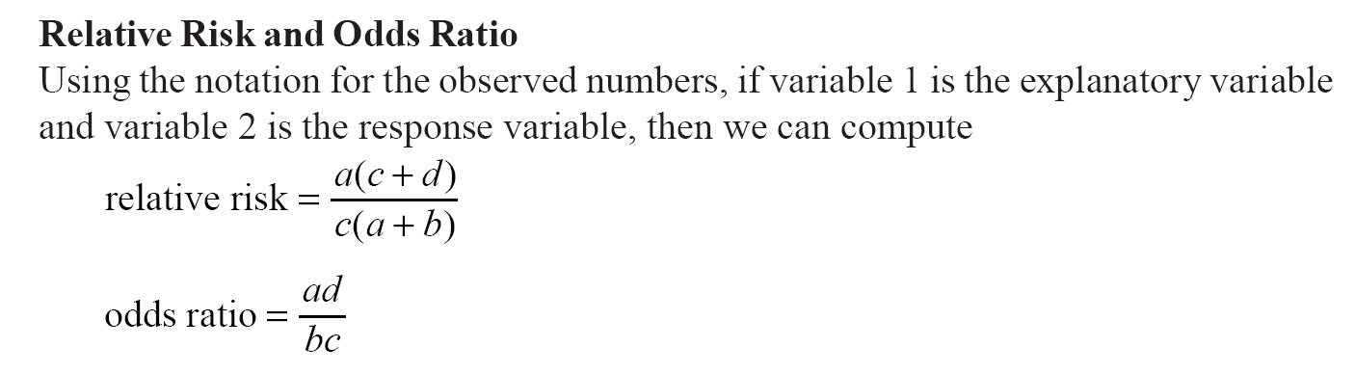
For Those Who Like Formulas

Slide 29
Simpson’s paradox (1 of 4)
Affecting the relationship between two variables, there may exist a lurking variable. Ignoring a lurking variable creates a reversal in the direction of the relationship that exists when the lurking variable is considered.
The lurking variable creates subgroups, and failure to take these subgroups into consideration can lead to misleading conclusions regarding the association between the two variables.
An association that holds for all of several groups can reverse direction when the data are combined to form a single group. This reversal is called Simpson’s paradox.

Slide 30
Simpson’s paradox (2 of 4)
Consider the survival rates for the following groups of victims, who were taken to the hospital either by helicopter or by road.
A higher percent of those transported by helicopter died. Does this mean that this (more costly) mode of transportation isn’t helping?
Counts | Helicopter | Road
Victim died | 64 | 260
Victim survived | 136 | 840
Total | 200 | 1100
Percents | Died | Survived
Helicopter | 64/200=32% | 68%
Road | 260/1100=24% | 76%

Slide 31
Simpson’s paradox (3 of 4)
Consider the survival rates when broken down by type of accident.
Serious accidents
Less serious accidents
Counts | Helicopter | Road
Died | 48 | 60
Survived | 52 | 40
Total | 100 | 100
Counts | Helicopter | Road
Died | 16 | 200
Survived | 84 | 800
Total | 100 | 1000
Percents | Died | Survived
Helicopter | 48% | 52%
Road | 60% | 40%
Percents | Died | Survived
Helicopter | 16% | 84%
Road | 20% | 80%

Slide 32
Simpson’s paradox (4 of 4)
Lurking variable: Accidents were of two sorts—serious (100) and less serious (1000).
Helicopter evacuations had a higher survival rate within both types of accidents than did road evacuations.
This is not evidence of the inefficacy of helicopter evacuation!
This is an example of Simpson’s paradox.
When the lurking variable (type of accident: serious or less serious) is ignored, the data seem to suggest that road evacuations are safer than helicopter evacuations.
However, when the type of accident is considered, the association is reversed and suggests that helicopter evacuations are, in fact, safer.
Can be dangerous to summarize information over groups!

Slide 33
Extra example Simpson’s paradox

Slide 34
Simpson’s Paradox: The Missing Third Variable
Relationship appears to be in one direction if third variable is not considered and in other direction if it is.
Can be dangerous to summarize information over groups.

Slide 35
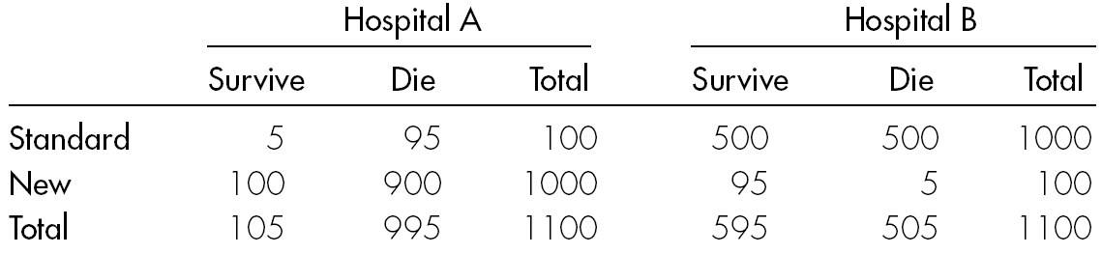
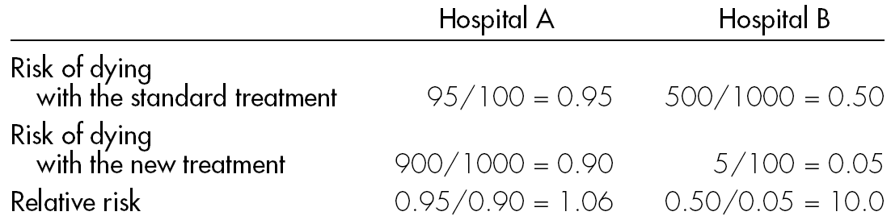
Example: Simpson’s Paradox for Hospital Patients
Survival Rates for Standard and New Treatments
Risk Compared for Standard and New Treatments
Looks like new treatment is a success at both hospitals, especially at Hospital B.

Slide 36
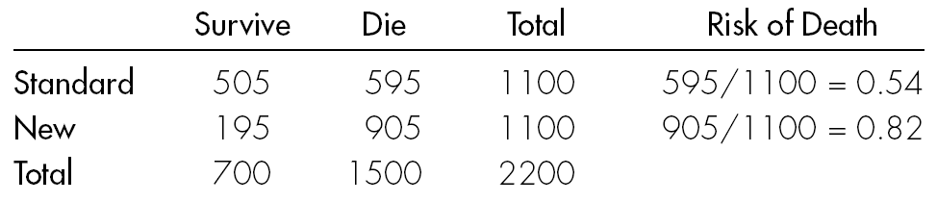
Example: Simpson’s Paradox for Hospital Patients
Estimating the Overall Reduction in Risk
What has gone wrong? With combined data it looks like the standard treatment is superior! Death rate for standard treatment is only 66% of what it is for the new treatment.
HOW?
More serious cases were treated at Hospital A (famous research hospital); more serious cases were also more likely to die, no matter what. And a higher proportion of patients at Hospital A received the new treatment.

